Slide 1
http://www.PredictionSoftwareInc.com

Slide 2
PRISM Prediction Reporting Inventory System Manager

Slide 3
PRISM Prediction Reporting Inventory System Manager
Purpose:
Lead manufacturers to improved productivity by providing logistics solutions which assist the process of sales forecasting, manufacturing, distribution and sales.

Slide 4
PRISM OVERVIEW
INTRODUCTION
About Prediction Software Incorporated
Overview of PRISM
SOFTWARE FEATURES & BENEFITS
Computer Aided Sales Forecasting
Continuous Replenishment Processing (CRP/SRO)
Hand-Held Computer Data Collection
System Wide / Perpetual Inventory
Maximum Floor Space Layouts
Production Schedule Generator
Raw Materials Ordering
Distribution Scheduling
Transport Scheduling Generator
Integrated Reporting, Charting & Graphics

Slide 5
Prediction Software Incorporated
SPECIALIZE IN PROCESS INDUSTRIES
More than 30 years of industry experience.
Inventory and logistics related software.
Internationalized products and services.
Consulting and software customizations.
PROVIDE INDIVIDUAL, PERSONAL SUPPORT
Technical support and maintenance.
Very quick response.
INNOVATIVE SOFTWARE COMPANY
Design creative, customizable solutions.
Extensive use of internet, remote control & cloud technology.
Deep experienced in beverage industry.

Slide 6
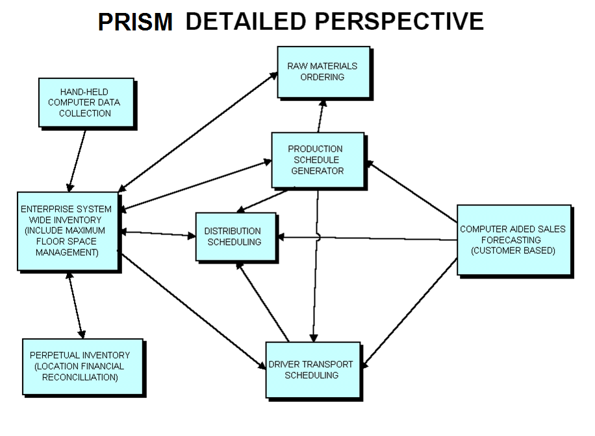

Slide 7
PRISM BENEFITS
Fully Integrated.
Easy to use, Microsoft Windows based system.
Works on Local Area Networks (LAN).
Capable of working with any relational, SQL or ODBC database.
Provides for simultaneous multiple user access.
Is a true client-server system with real-time capability.
Adds consistency and standardization to the operation.
Improves management access to needed decision making data.
Provides numerous reports and charts for analysis and performance measurement.
Improves communications between locations and in the supply chain.
Many other benefits to management and information systems.

Slide 8
PRISM Sales Forecasting Benefits
Increased Forecast Accuracy.
Improved customer service.
Reduced out-of-stocks, increased product availability.
Lower inventory, lower holding cost, easier to rotate stock.
Less out-of-date product, less spoilage. Fresher better tasting product.
Smoother scheduling operations.
Allows distribution network access to automated forecasts.
Location specific customer groups.
Quick access to sales history through a variety of reports and charts.
Saves time of sales managers.

Slide 9
Continuous Replenishment Processing CRP/SRO Supply Replenishment Ordering - Benefits
Automatically generates highly accurate time-phased suggestion of product shipments to individual store locations or routes.
Eliminates the need for store management to place orders for product. Systematizes replenishment.
Significantly reduces out-of-stocks and overstocking at stores.
Greatly improves utilization of distribution trucks.
Leverages accurate daily sales forecast by SKU by store.
Eliminates “sales voids” of forgotten products by ensuring even slow selling products are maintained in stock. Increases sales.
Can import and use actual sales scan data from the point of sale.
Allows import, edit and control of delivery schedules, reorder quantities, minimum inventory level, min by days supply, maximums, percent sales by day, inventory, shipments and sales.
Automatically computes and uses fresh percent sales by day.
Lets you analyze, study and chart the data and share with customer.

Slide 10
Hand-Held Computer Data Collection
Collect physical inventory of both raw materials and fullgoods.
Ability to scan UPC or Bar codes.
Track Physical Inventory Location within the facility.
Paperless data collection.
Faster counting. Inventories are available earlier.
More Accurate. Computer does all the mathematical computations and accumulation.
Eliminates the need to retype data manually, uploads to host automatically.
Possible headcount reduction or personnel redeployment due to time savings.
Software is compatible with all pen based hand-held computers.

Slide 11
System Wide Inventory
Fully Automated.
Comprehensive by SKU, by Location, daily. Can see entire distribution network inventory earlier.
Provides for high level management of inventory across the enterprise.
Global perspective of enterprise leads to improved decision making.
Assists with development of effective floor space inventory maximums.
Calculates days supply, potential lost sales, Out-Of-Stocks (coverage, imminent), maximums, etc.
Helps manage floor space utilization.

Slide 12
Perpetual Inventory
Customizable.
Has cost capability.
Ability to track breakage, shrinkage. Control product loss, theft.
Can interface daily sales / route truck outload.
Estimates inventory (based on activity) when actual inventory is not available.
Tool to assist with financial reconciliation process.
Improves accuracy of data from all processes, production, shipping, sales, etc.
Helps provide better management of inventory assets, better control.

Slide 13
Production Scheduling
Automatically suggests production schedule by SKU, by plant, by line, by batch, by time, by shift.
Based on days supply.
Allows manual overrides.
User controls the parameters which guide the system such as production rates, changeover costs, sanitation ordering, raw material limitation and batch sizes.
Considers long term requirements.
Improves product availability, reduces out-of-stocks.
Helps reduce manufacturing cost by scheduling optimal, lowest cost scenario.
Assists with third party product purchase decisions.
Helps remove human error from the scheduling process.
Possible headcount reduction or personnel redeployment due to time savings.

Slide 14
Raw Material Ordering
Suggests raw material orders for Just-In-Time and Min/Max by line, by truck, by date/time, by supplier.
Verifies correctness of any manual changes by automatic comparison to production schedule.
Supports raw material substitutions.
Supports multiple suppliers for each material.
Avoids possible downtime due to running out of packaging or ingredients.
Has the ability to generate EDI, e-mail, or cloud/web services releases.
Provides on-line receiving capability, for comparison to order.
Helps remove human error from the scheduling process.
Possible headcount reduction or personnel redeployment due to time savings.

Slide 15
Distribution Scheduling and Shipping Documentation
Suggest load contents. Send fair share based on days supply.
Help minimize Out-Of-Stocks
Maximize direct loading from production lines.
Utilize location parameters such as maximums, forecasts, inventories, etc.
Prints bills of lading and forklift loading tickets.
Provides advanced shipping notice at receiving locations.
Provides automatic receiving documents and an unmatched shipper/receiver report.
Provides shipping and receiving document reconciliation.
Reduces product double handling, back hauls and redistribution.
Reduces misloads caused by illegible hand written forms.
Eliminates problems associated with invisible “in transit” inventory.

Slide 16
Driver Transport Scheduling
Suggests driver transport schedule, truckload requirements by location, by day.
Reduces labor cost by minimizing over/under time. Fully utilize paid hours.
Improves utilization of expensive assets like tractors and trailers.
Reduces waiting time at unloading docks by scheduling according to delivery windows.
Can improve warehouse route loading efficiency by scheduling transport arrivals during non-peak hours.
Helps remove human error from the scheduling process.
Allows junior employees to easily schedule in absence of senior scheduler.
Possible headcount reduction or personnel redeployment due to time savings.

Slide 17
PRISM Technical Information
Internationalized (localized), date, time, numeric & currency.
GUI system, operates in modern Microsoft Windows environments including Windows 10 and Windows Server.
Based on Embarcadero FireDAC Database Engine (Successor to BDE) making it compatible with any relational, SQL or ODBC database, including Oracle, Sybase, Infomix, DB2, Paradox, etc.
Is a true client-server system with real-time capability and can be setup in a distributed environment.
Can run remotely using Citrix, RDP Remote Desktop, or in distributed DB.
Object oriented design (OOP).
Written in a combination of C++ and Object Pascal languages.
Approximately 1.5 Million+ lines of code.
Very open system offering numerous interfaces and file conversion utilities.
Printed documentation available.

Slide 18
Client Workstation Minimum Configuration
Pentium Core2 or i7+ class processor, 3 Ghz +
16 GB+ RAM
50 GB free space on hard drive
Color monitor, large screen preferred
TeamViewer remote control software
Microsoft Windows 64 Bit OS systems
Mouse
Printer

Slide 19
File Server Minimum Configuration
Pentium Core2 or i7+ class processor
32+ GB RAM
250 GB Hard drive space dedicated to PRISM
64 Bit Network Operating System
Backup system and software
Battery backup power supply
100 Mbps Ethernet or higher wired or wireless
Hubs, switches, routers and cable system

Slide 20
PRISM Computerized Inventory Management System
Sales Forecasting

Slide 21
What is Sales Forecasting?
Process to accurately predict future sales.
Use past historical sales data.
Use information about the future
Weather
Promotions
Seasonality
Price and other factors
Use statistical methods.

Slide 22
$ Why is Forecasting Important? $
Improves customer service.
Lower operating cost.
Allows optimization of the supply chain.
Cannot optimize production or distribution without an accurate sales forecast.

Slide 23
Accurate Forecasting Benefit: Less Out-of-Stocks
Improved customer service.
Right product.
Right place.
Right time.
Right quantity.
Increased sales.
Helps bottler achieve increased growth.

Slide 24
Accurate Forecasting Benefit: Reduced Inventory
Do not need as much to cover large variance associated with inaccurate forecast.
Less full goods / Finished product.
Less raw, packaging & ingredient materials.
Inventory = $ Money. Do not tie up as much.

Slide 25
Accurate Forecasting Benefit: Less Product Spoilage
Excess inventory is reduced.
Less product becomes out-of-date.
Fresher, better tasting product for customer.
Higher quality product.
Easier to rotate minimal stock level in warehouse.

Slide 26
Accurate Forecasting Benefit: Deferred Capital Investment
Less production capacity is needed.
Less warehousing space is needed.
Company can wait longer before building.
Gives ability to do better job with less.
Improves utilization of existing resources.

Slide 27
Accurate Forecasting Benefit: Smoother Operations
Reduced redistribution between locations.
Avoid short notice scheduling changes.
Reduced production & distribution overtime.
Lower labor cost.
Less small production runs, higher yield.
Fewer production change overs.
Ability to schedule limited production capacity to cover short term increases in demand.

Slide 28
PRISM Sales Forecasting Software
Microsoft Windows based.
Graphical User Interface (GUI).
Network compatible.
Complete software system.
Database.
Statistical methods.
Reporting, Charting & Performance Measures.
Customized for beverage sales forecasting.
Available in multiple language versions.

Slide 29
Simplified Automatic Forecasting
Forecasting method incorporates :
Seasonality.
Holidays.
Year over year growth indexing.
Exponential smoothing.
New product introductions.
Seasonal Products
Completely Automatic.
Very fast.
Gives the user more time to focus on key products and key customer forecasts.

Slide 30
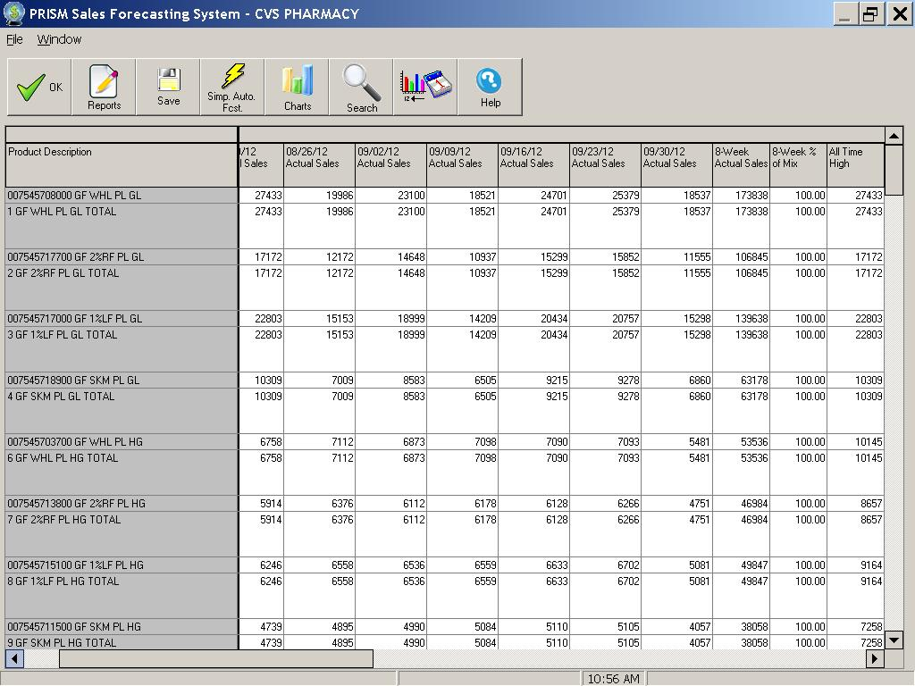
PRISM Screen shows recent actual sales, percent
of mix, and all time highest weekly sales.

Slide 31
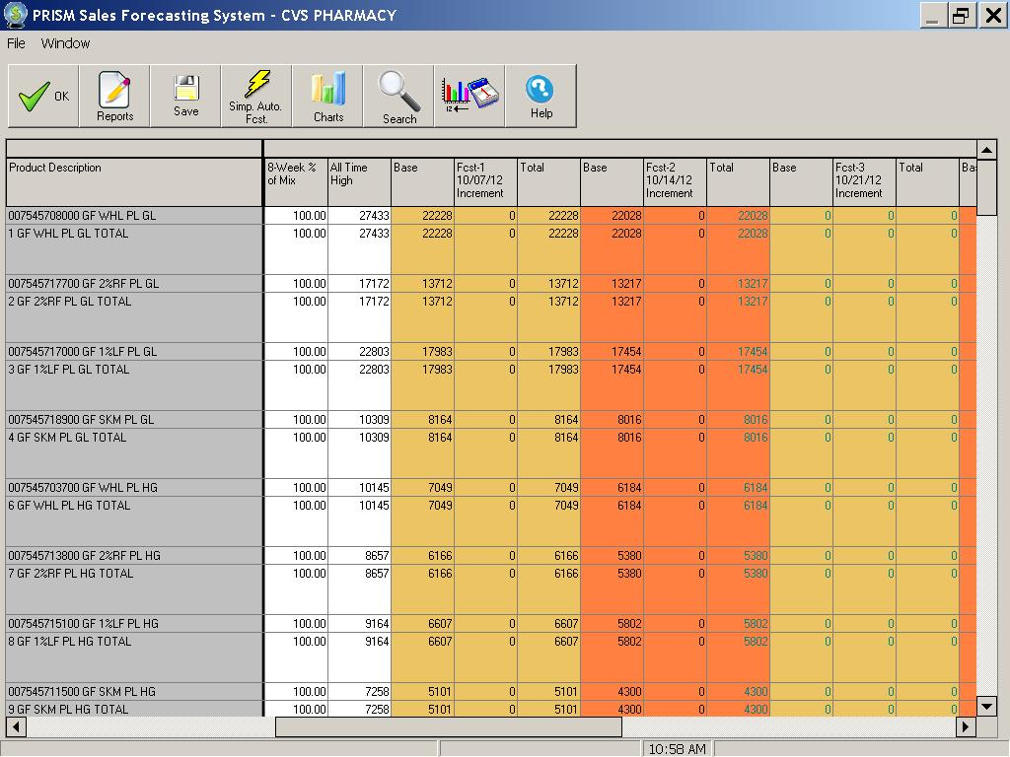
PRISM Screen shows base, incremental
and total forecast for one week.

Slide 32
Account Group Forecasting
User defined grouping of customers.
By individual customer, route, segment or channel.
User defined motivating factors.
Promotions, weather, price, competitors price, advertisements, coupons or other factors.
Automatic sales prediction by account group.
Accumulated to create sales region or warehouse total forecast.

Slide 33
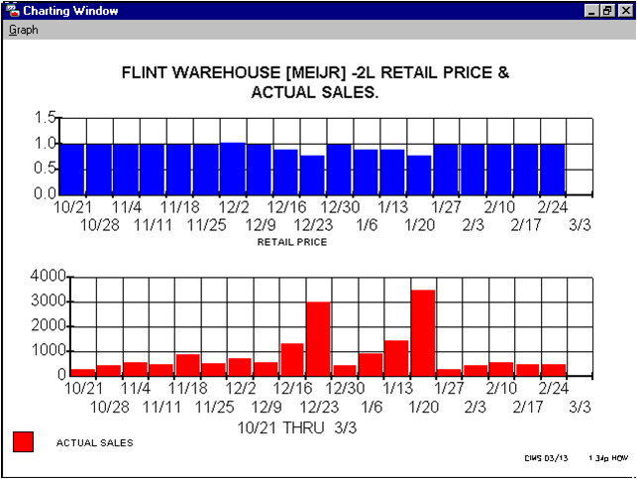
PRISM graph correlates sales history and motivating
factor “Retail Price” for one account group.

Slide 34
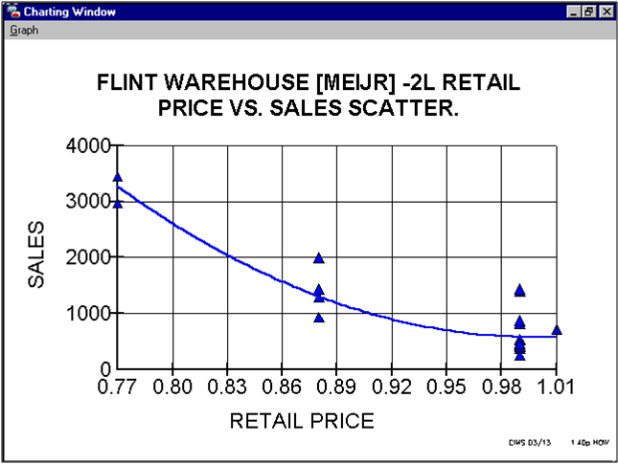
PRISM graph shows best fit curve relating the motivating
factor “Retail Price” to expected sales volume.

Slide 35
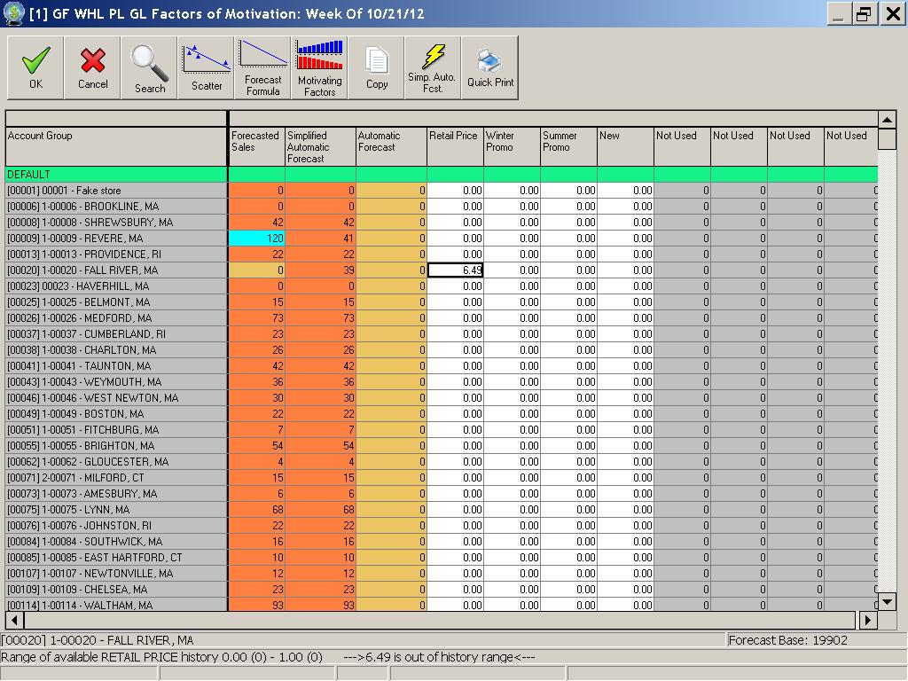
PRISM screen helps the user by quickly generating an
accurate prediction from the motivating factors.

Slide 36
Measuring Forecast Performance
Cannot improve what is not measured.
Feedback / Report Card.
Causes of error must be identified.
Track & use past successes and failures.
Reporting, quantitative analysis.
Charting and graphical analysis.
Trends.
Relationships.

Slide 37
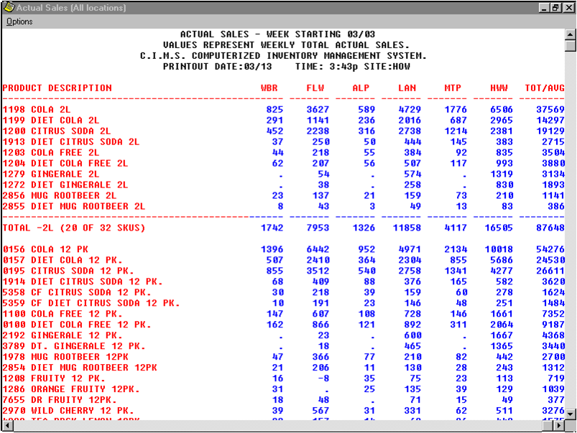
PRISM report, viewed on screen, shows actual sales
or other data for many distribution centers.

Slide 38
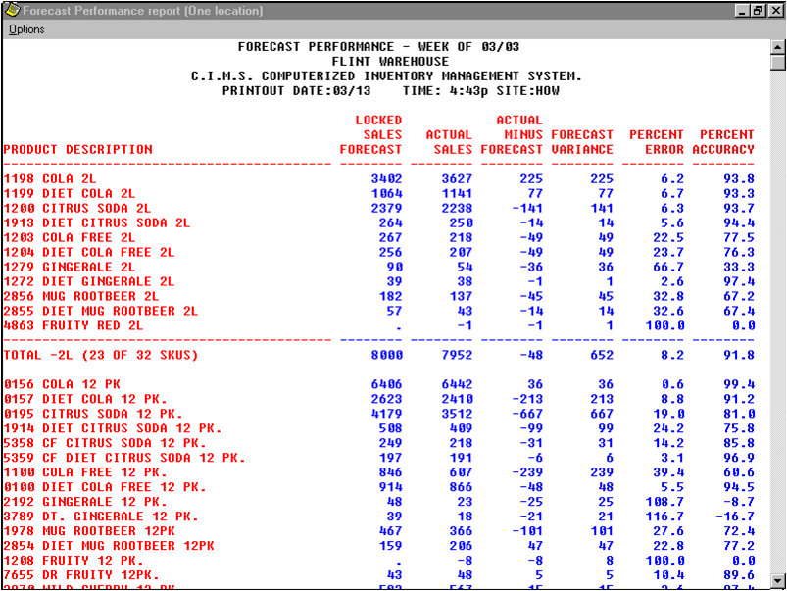
PRISM report, viewed on screen, shows analysis
of forecast accuracy for one sales center.

Slide 39
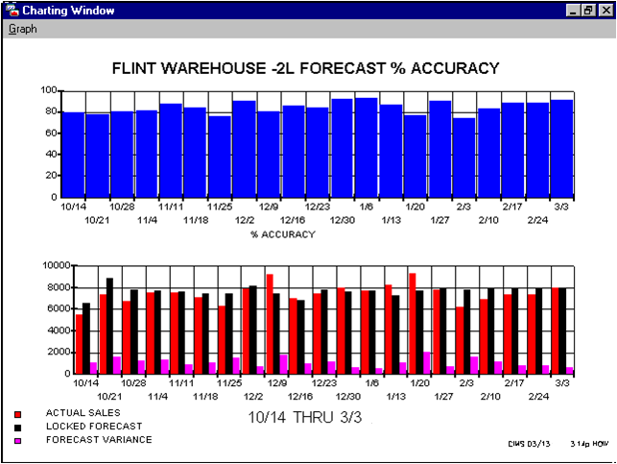
PRISM graph shows trend of forecast accuracy
over time for one package and sales center.

Slide 40
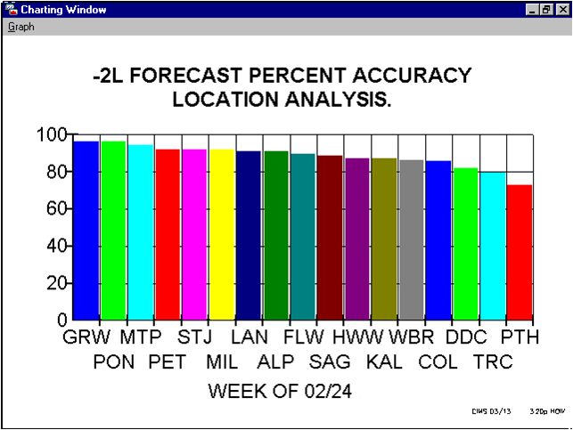
PRISM graph shows ranking of sales
center accuracy from best to worst.

Slide 41
Centralized or Decentralized?
Advantages of centralized organization.
Less communication is required.
May be more consistent with goals of the company.
Advantages of decentralized organization.
More “ownership” at remote locations.
Easier to use local market information.
Hybrid organization is sometimes best.

Slide 42
What is required to implement a Sales Forecasting System?
Leadership and backing from senior management.
Clear definition of objectives.
Initial investment in computer hardware and software.
Install and implement the system.
User training to adopt new procedures.

Slide 43
Accurate Sales Forecasting Conclusion
Necessary part of a successful logistics system.
Forecast is a key driver to operations.
Accurate sales forecasting is directly correlated to operating cost.
Hardware & software systems are readily available and easily cost justified.

Slide 44
PRISM Computerized Inventory Management System
Continuous Replenishment Processing CRP/SRO Supply Replenishment Ordering

Slide 45
What is S.R.O.?
SRO uses CRP methods – Continuous Replenishment
Replace sold product at store using scan data.
Future Demand Planning is central to the SRO process.
Generates and Uses Customer and Store level Sales forecasts.
Careful Anticipation of Customer needs using delivery schedules.

Slide 46
S.R.O. Supply Replenishment Ordering – Benefits
Automatically generates highly accurate time-phased suggestion of product shipments to individual store locations or routes.
Eliminates the need for store management to place orders for product. Systematizes replenishment.
Significantly reduces out-of-stocks and overstocking at stores.
Greatly improves utilization of distribution trucks.
Leverages accurate daily sales forecast by SKU by store.
Eliminates “sales voids” of forgotten products by ensuring even slow selling products are maintained in stock. Increases sales.
Can import and use actual sales scan data from the point of sale.
Allows import, edit and control of delivery schedules, reorder quantities, minimum inventory level, min by days supply, maximums, percent sales by day, inventory, shipments and sales.
Automatically computes and uses fresh percent sales by day.
Lets you analyze, study and chart the data and share with customer.

Slide 47
Analysis of SRO Requirements
Setup and Configuration data. i.e. sales calendar, options, etc
Product Master Tables.
Location, Plant and Customer/Store Master.
Route Delivery Schedules, Minimums, Reorder Quantities.
Complete Store Level Forecast with daily resolution; promotional correlations.
Database of Store Level Inventory, Sales, Shipments.
Database of Percent Sales by Day by SKU by Store.
Import utility to accept sales & inventory data from Stores.
Hand-Held Inventory Data Collection tools available.
Complete Reporting, Analysis and Charting.
Speed. It quickly generates new orders every day.

Slide 48
File Conversion Utility Main Screen

Slide 49
Import Sales Scan Data

Slide 50
Import Many Data Types, Inventory & Shipments

Slide 51
Sales Forecasting System Main Screen

Slide 52
Edit All Data Types by Store Location and Product

Slide 53
Account Group Database

Slide 54
Customer Table Defines Individual Store Locations

Slide 55
Delivery Schedules Organize the Days Each Store Can Receive Shipments

Slide 56
Percentage of Sales By Day Computed During Import of Sales and Editable

Slide 57
Reorder Quantities Organize the Best Distributable Allocations

Slide 58
Set Forecasting Statistical Method by Store Location and Product

Slide 59
Edit or Set Parameters in Bulk for Locations & Products with Similar Requirements

Slide 60
Forecasting Editor - Select Date, Location and Horizon

Slide 61
Review Recent Actual Sales and Current Sales Forecast Horizon

Slide 62
Detailed Forecasting by Customer Account Group and Product

Slide 63
Graphically Review and Use Customer Level Data

Slide 64
Selectively Generate or Update Sales Forecasts by Time Frame and Product

Slide 65
Charting Past Actual Sales Data From Any Time Frame

Slide 66
Integrated Reporting & Charting Application for Data Analysis

Slide 67
Hundreds of Pre-Built Reports Can be User Customized

Slide 68
Planned Order Analysis Report

Slide 69
Audit the Detailed Solution

Slide 70
See and Check the Data

Slide 71
Time Phased Analysis of Suggested Planned Orders

Slide 72
Export Planned Orders to XML, CSV or Fixed Formats

Slide 73
PRISM Computerized Inventory Management System
Hand-Held Computer Data Collection

Slide 74
Problems with Traditional Manual Inventory Counting Methods
Uses Pen/Pencil and clipboard.
Uses forms which must be created ahead of time. Forms have lots of lines and boxes, limited space to record, and several pages may be required based on the # of SKUs.
Illegible manual handwriting.
Manual Reconciliation - must remember conversion factors (units/pallet, units/layer), must read numbers of hand written sheet.
User must perform calculations using a calculator and usually record, by handwriting, the total prior to data entry.
Data entry into the host computer is sometimes performed by a different person causing a delay in the time that the inventory is available in the system.
Mistakes are commonly made during the manual data entry due to hard to read handwriting or entering in the incorrect number into the host, or entering the incorrect product code or line number.

Slide 75
Summary of Traditional Methods
Traditional manual methods take a lot of time, could involve several people in the process, are very prone to error, and cause delays in getting the data to the people who need it (i.e. inventory controller/clerk, production/distribution department, etc.).
Because traditional methods take such a long time to complete the entire process accurately, sometimes companies resort to partial counts or package only counts or sometimes no count at all. This hurts the supply chain because it forces production and distribution to use old or estimated information, and limits the ability to react quickly to specific SKU inventory changes. This also limits the controllers ability to catch inventory shrinkage.

Slide 76
PRISMpad Benefits
Paperless data collection
Familiar user interface looks and feels like pen & paper
Records transaction type & location address of inventory
Records date code, batch number, sequence & S/N of inventory
Allows bar code scanning of UPC, GS1-128 and custom labels. Prints custom barcode labels of various sizes with mobile printer.
Handwriting recognition
Eliminates all mathematical computations and errors
Supports variant conversion factors
Directly interface with PC, network or mainframe
Automatically synchronizes with product database
Much quicker data collection, large time savings
Reduce out-of-stocks, overstocks. Better data, better decisions
Increase loading efficiency
Requires very little training, easy to support

Slide 77
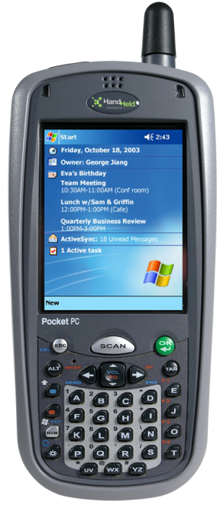
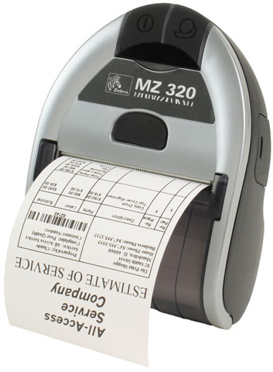
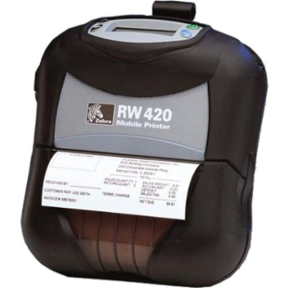
Hand-Held Computers & Printers

Slide 78
Partial List of Supported Pen-Based Systems
Honeywell Hand-Held Products Dolphin 7900
Motorola MC75
Intermec Norand CN2
Intermec Norand 730 Series.
Most Pocket PC & Windows Mobile devices
Some smart phones with Windows Mobile

Slide 79
PRISM Compatible Hand-Held Computers
System Requirements :
Windows Mobile / Pocket PC.
Pen-Based Touch Screen Device.
240 x 320 or higher video display.

Slide 80
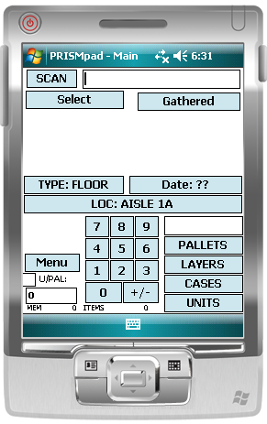
PRISMPAD – Main Screen

Slide 81
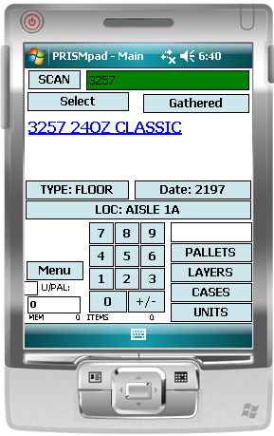
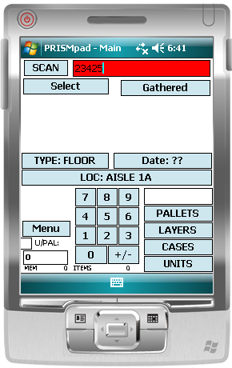
PRISMPAD – Scan Bar Codes Supports all Barcode Symbologies including UPC, GS1-128 or Custom
+”Good” Scan Sound
+”Bad” Scan Sound

Slide 82
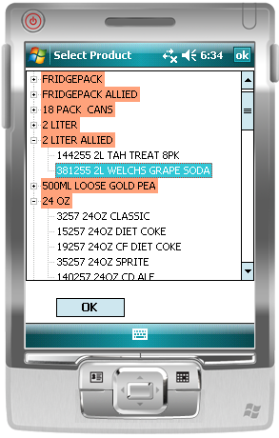
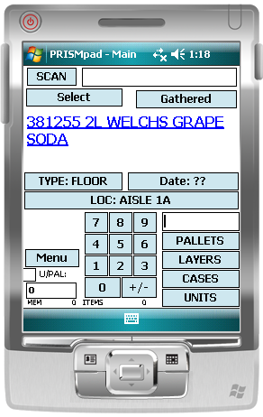
PRISMPAD Select Package & Flavor, Choice Displayed on main Screen

Slide 83
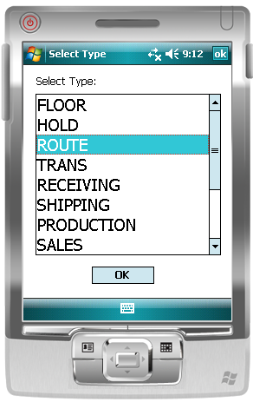
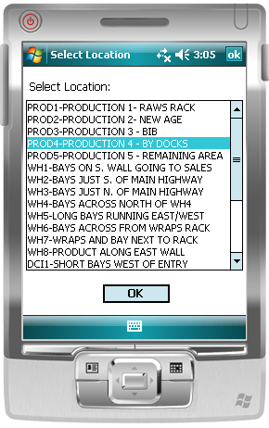
PRISMPAD Select Inventory Type & Location

Slide 84
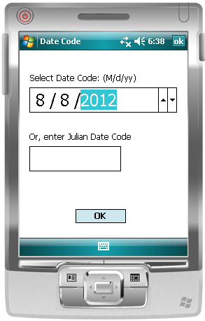
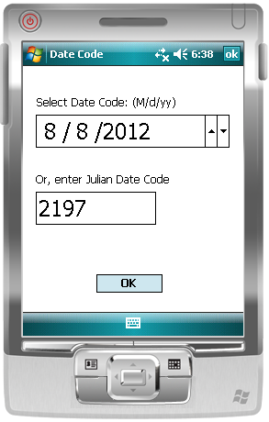
PRISMPAD Optionally Record Date Codes – Two Ways

Slide 85
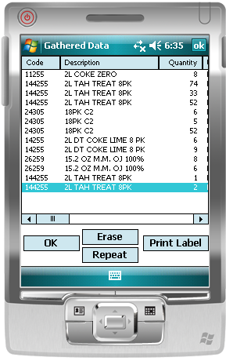
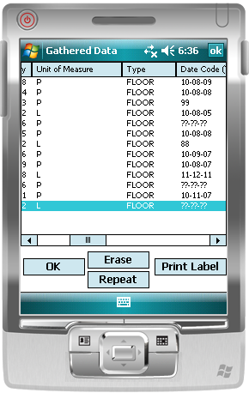
PRISMPAD View Gathered Data, Erase, Repeat

Slide 86
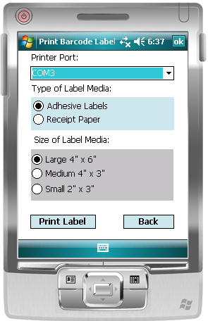
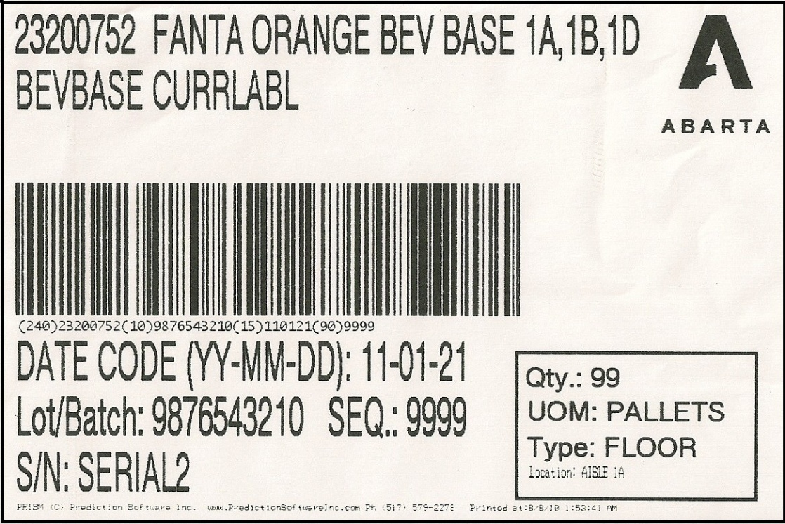
PRISMPAD Print Adhesive Barcode Labels using Mobile Printer

Slide 87
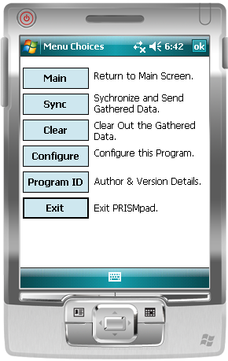
PRISMPAD Other Options on Menu Choices Form

Slide 88
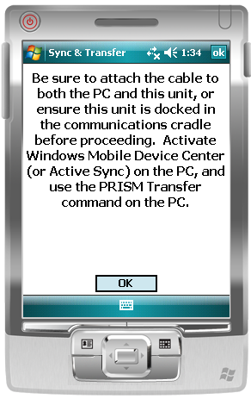
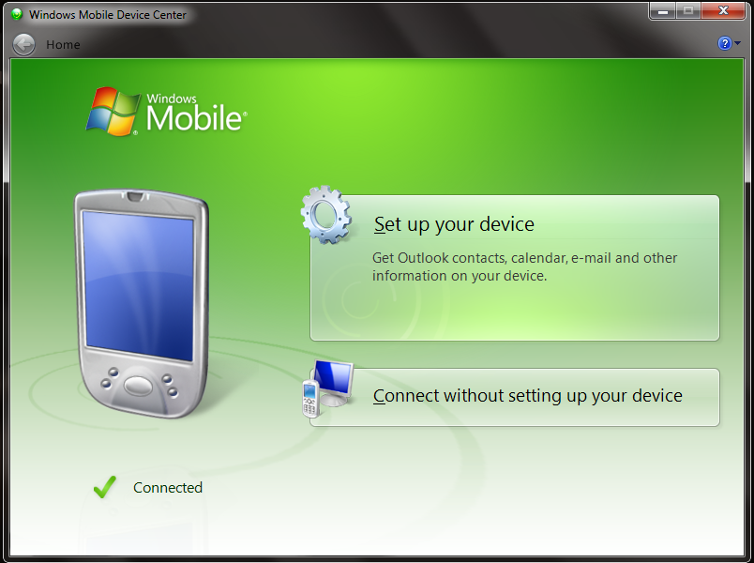
PRISMPAD Transfer Data with Windows Mobile Device Center or Active Sync

Slide 89
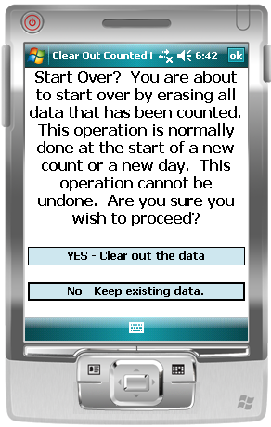
PRISMPAD Clear out old data and start a new count.

Slide 90
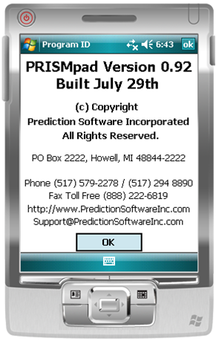
PRISMPAD View Program Version Details

Slide 91
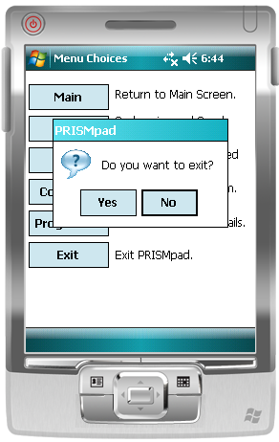
PRISMPAD Confirm Exit

Slide 92
PRISMpad Changes Needed to Support Predictive Ordering
Target User Audience Shift
Support for Multiple Hardware and Operating System Platforms
Application Simplification, Feature Access Control and Limits
User Authorization and Authentication Control by P.O.D.

Slide 93
Target User Audience Shift
Current application is focused on warehouse managers at beverage plants
New version must focus on grocery managers at retail stores
Become an application streamlined for mass deployment to hundreds or thousands of users
Goal of zero end-user training needed

Slide 94
Support for Multiple Hardware and Operating System Platforms
Android phones and tablets
Apple iOS phones and tablets
Windows tablets and Windows desktop
Apple OS X Desktop
Support for bar code scanning using cameras

Slide 95
Application Simplification, Feature Access Suppression
Some different features are needed in the new version, i.e. scan with camera
Many current features are not as valuable to the new intended user base or application, i.e label printing, bill of material features
Fields less useful include date code, product type, S/N, aisle/row location, sequence, lot/batch, variant unit of measure, etc.
Reduce unit of measure choices to only relevant choices for the current product and store, i.e. cases, maybe bossies, not pallets

Slide 96
User Authorization and Authentication Control by Predictive Ordering Dept.
POD to control user activation & continued access
User authentication: request for full access* using the mobile application
POD to use PRISM to reply with access code granting authorization. Access code is revocable.
POD to control product list and associated settings such as valid units of measure, by product, by store
100% Secure File Transfer Protocol used to transmit data files in both directions.

Slide 97
Typical product cooler containing inventory
Go paperless and speed up the process of counting inventory.

Slide 98
Scan any item using UPC barcode

Slide 99
Scan Bar Code using integrated camera
Use the camera built into most smart phones and tablets to scan the inventory item.

Slide 100
Scan Bar Code using camera integrated into tablet
Place the barcode inside the viewfinder rectangle to scan it.

Slide 101
Bar Code Scan w/Camera
Because most smart phones lack a CCD or laser scanner, we can use the integrated camera to capture and decode the UPC or other bar code.
User will be able to confirm the scan by reviewing the matching product description.
User can scan product UPC codes even if they are not yet activated for their store.*
Different sounds and different screen colors can be use to distinguish between activated products or inactivated products.

Slide 102
Scan Bar Code w/ Camera
User can reject the scan.

Slide 103
PRISM Computerized Inventory Management System
System Wide Inventory

Slide 104
System Wide Inventory Editor
Fully Integrated with other PRISM modules.
Comprehensive by SKU, by location daily.
Estimates inventory (based on activity) if actual is unavailable.
Provides integrated reporting and charting
Days Supply, Product Locations, Date Codes
Out-Of-Stock, shows coverage & imminent
Potential Lost Sales
Maximums / Percent Utilization, many others
Enterprise “Global” view improves management of valuable inventory resources.
Works with hand-held computers to reduce errors, time & paperwork.
Export data to legacy and third party systems

Slide 105
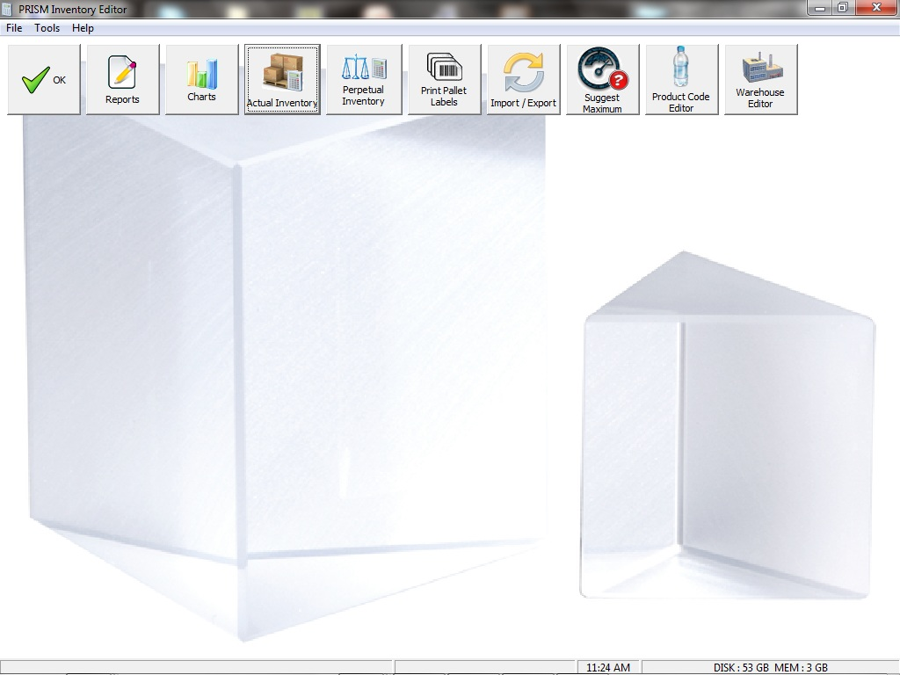
PRISM System Wide Inventory Editor Main Screen

Slide 106
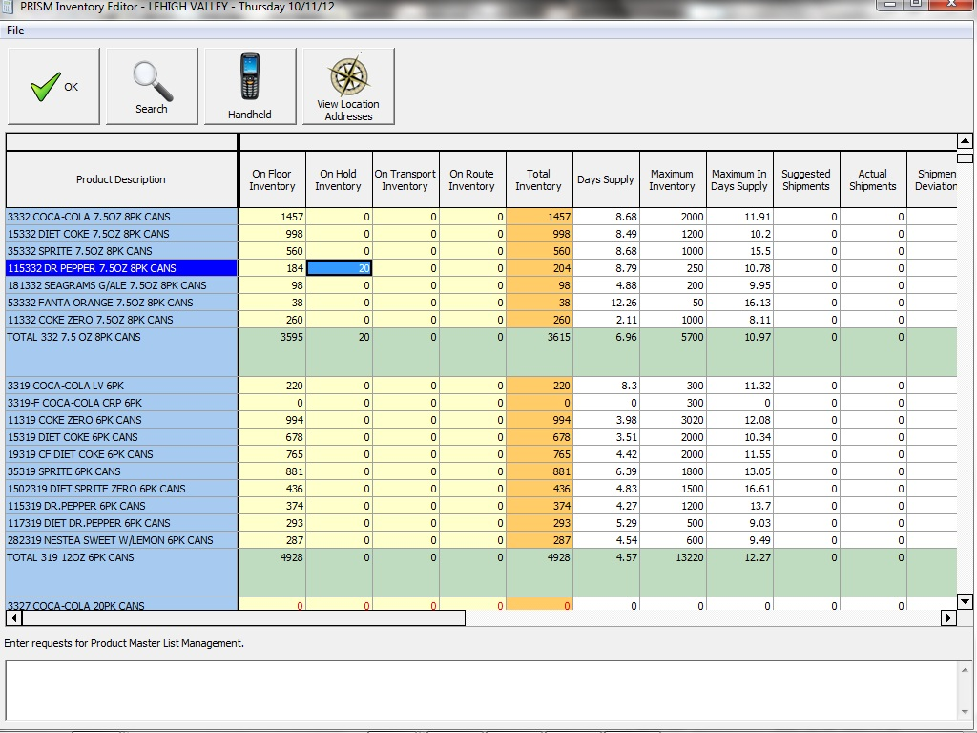
PRISM System Wide Inventory Editor allows viewing and editing actual floor, hold, transport, route and total inventory.

Slide 107
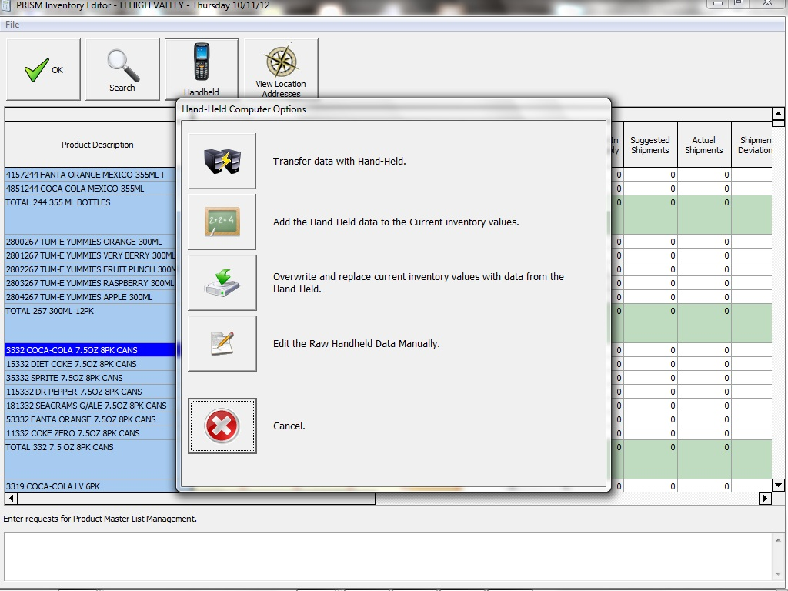
Inventory Editor also shows Days Supply, Maximum Inventory, Maximum Days Supply, Suggested Shipments, Actual Shipments, Shipment Deviations and Future Forecasts, if Available.

Slide 108
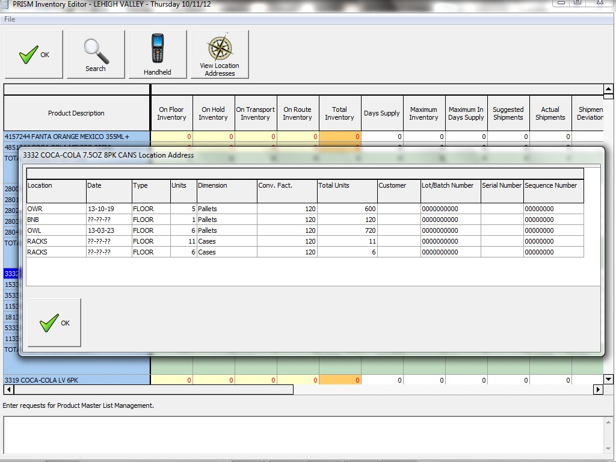
Inventory Editor Provides view of Product Locations and Date Codes

Slide 109
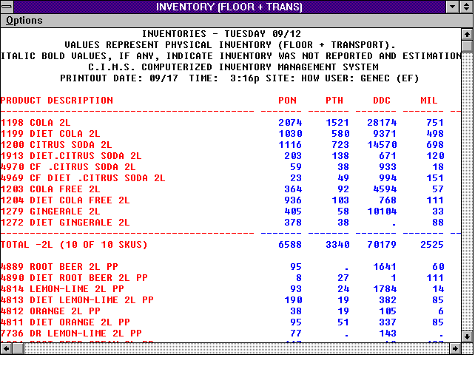
Inventory Editor Reports Can be Viewed on Screen, Printed and Exported

Slide 110
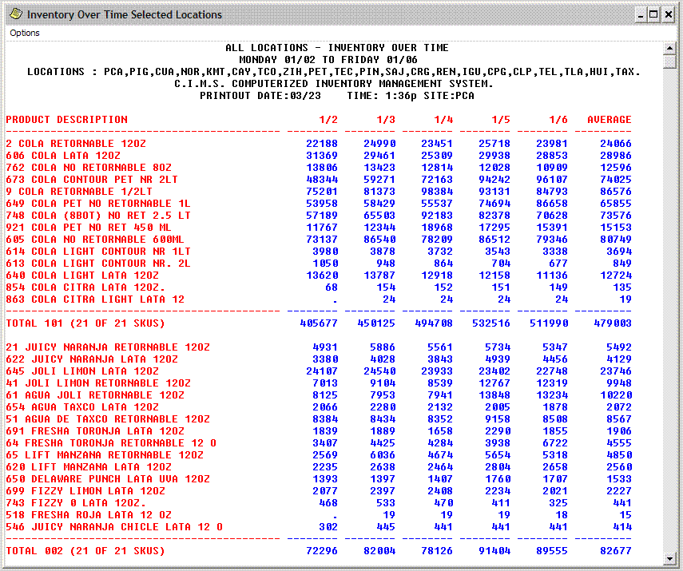
Inventory Editor Example of Inventory Over Time Report

Slide 111
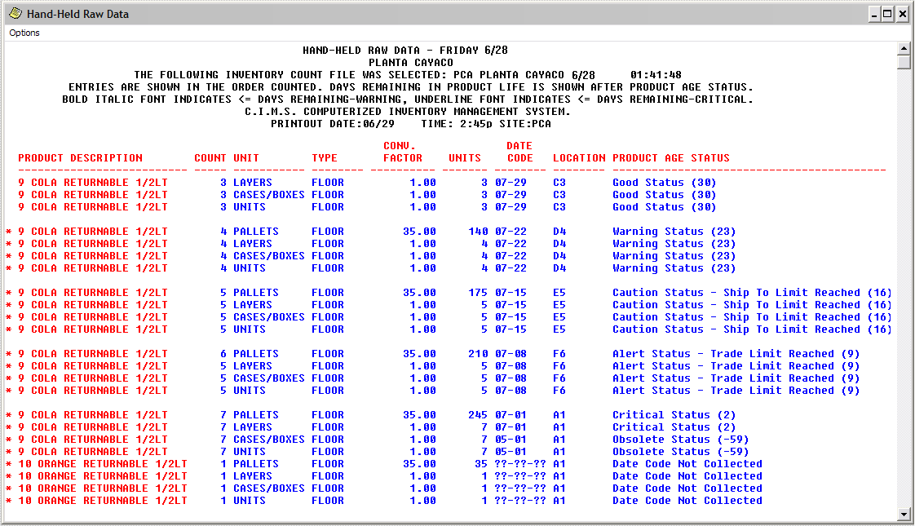
Inventory Editor Example Hand-Held Raw Data Report

Slide 112
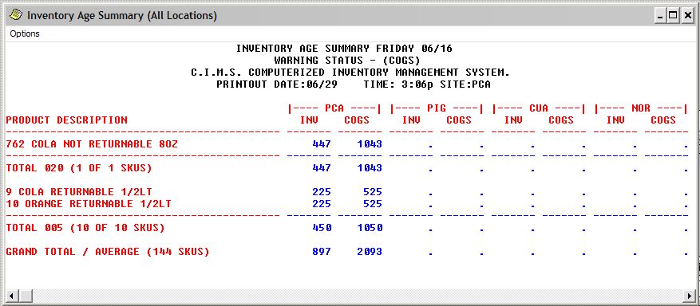
Inventory Editor Example of Inventory Age Summary Report – Shows the entire enterprise inventory for multiple warehouses filtered by age status class and associated cost of goods. Excellent tool for reducing product obsolescence.

Slide 113
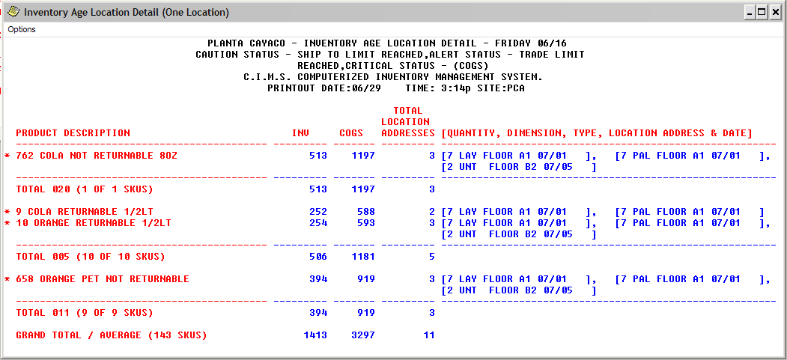
Inventory Editor Example Inventory Age Location Detail Report – Shows warehouse level inventory filtered by age status class and associated cost of goods. Another excellent tool for reducing product obsolescence.

Slide 114
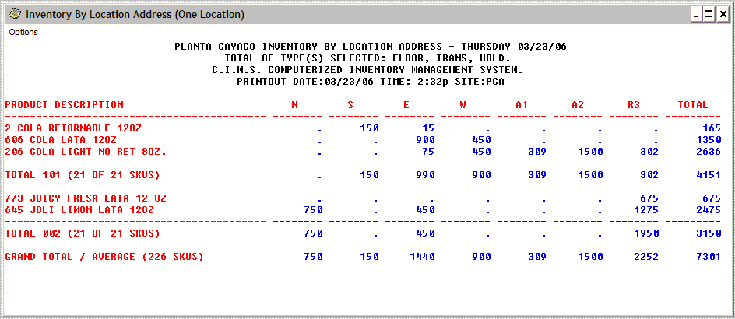
Inventory Editor Example of Inventory by Location Address Report

Slide 115
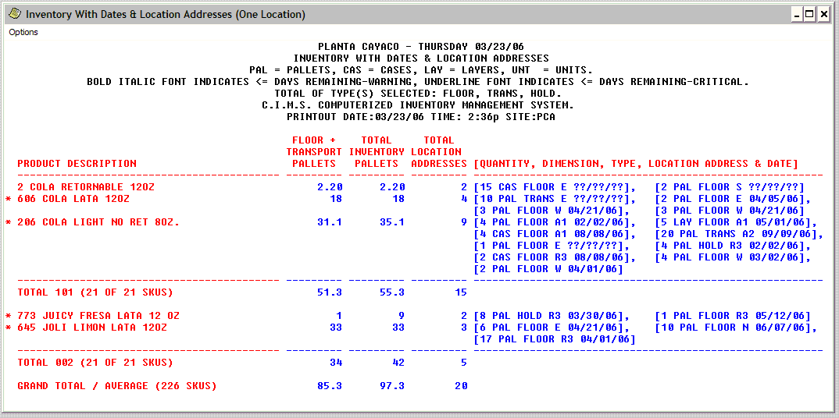
Inventory Editor Example of Inventory with Dates & Location Addresses Report

Slide 116
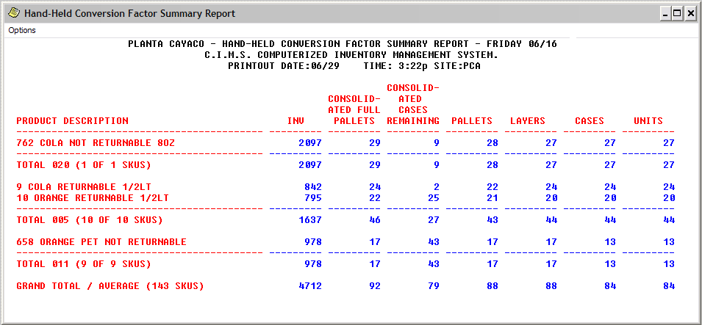
Inventory Editor Example of Hand-Held Conversion Factor Summary Report. Shows the inventory consolidated into pallets and remaining cases, plus the number of entries made with the hand held computer at each conversion factor, pallets, cases, layers or units.

Slide 117
Inventory Editor Integrated Graphical Analysis and Charting

Slide 118
Inventory Editor Integrated Graphical Analysis and Charting

Slide 119
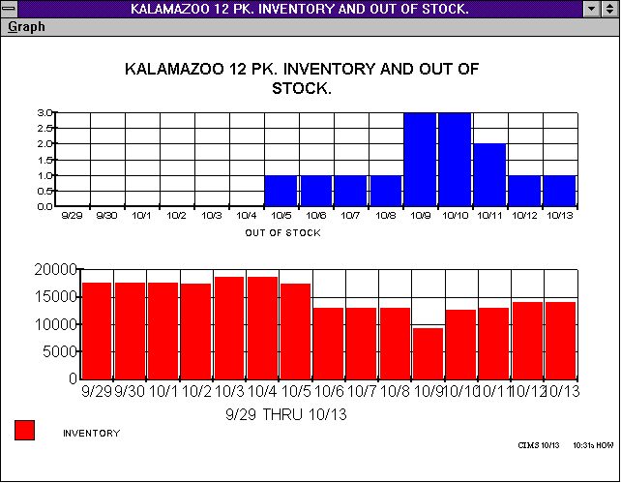
Inventory Editor Integrated Graphical Analysis and Charting

Slide 120
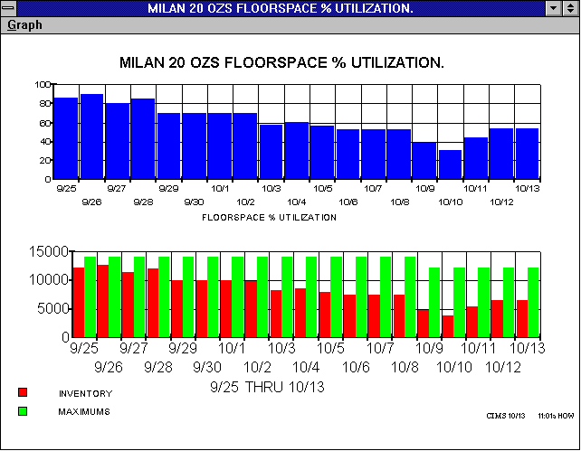
Inventory Editor Integrated Graphical Analysis and Charting

Slide 121
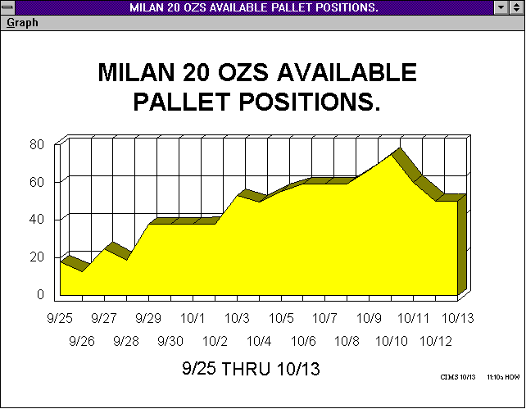
Inventory Editor Integrated Graphical Analysis and Charting

Slide 122
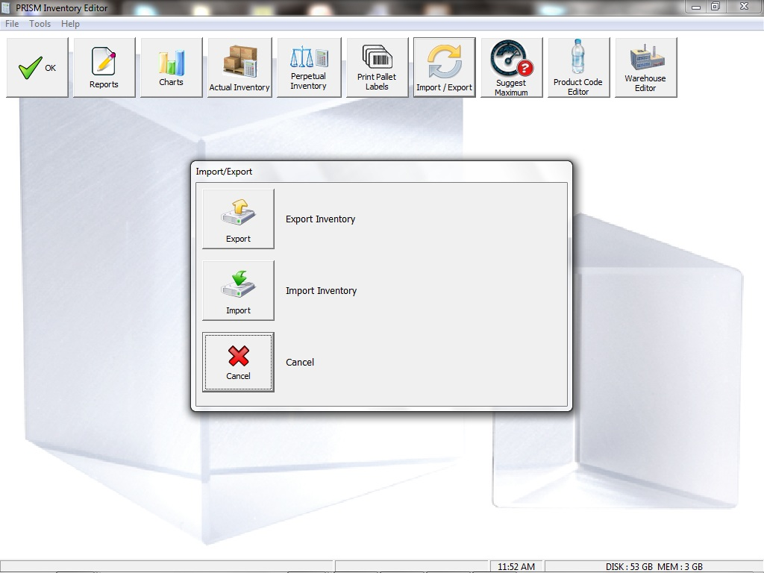
Inventory Editor Export Inventory Data to Legacy and Third Party Systems

Slide 123
Summary of PRISM Inventory Benefits Improved Data Quality, Large Time Savings
Mature, stable system, proven in the industry.
Dramatically speeds up the process.
Eliminates math error, paper, keypunching and saves steps.
Improves data quality. Improves supply chain decisions.
Tool to manage breakage / shrinkage. Control product loss, theft.
Supports earlier daily financial reconciliation process.
Interface with existing systems.
Can estimate inventory when actual inventory is not available.
Helps provide better management of assets, better control.
Very rapid investment payback

Slide 124
PRISM Computerized Inventory Management System
Perpetual Inventory

Slide 125
PRISM Perpetual Inventory Editor
Customizable.
Tool to manage breakage / shrinkage. Control product loss, theft.
Supports daily reconciliation.
Can interface with daily sales & outload.
Tool to assist with financial reconciliation process.
Estimates inventory (based on activity) when actual inventory is not available.
Helps provide better management of inventory assets, better control.

Slide 126
Uses of the Perpetual Inventory Editor
User can configure their own unique transaction types
Automatically imports transactions from other PRISM modules.
Can be set to allow users to manually enter transactions
Constantly updates the theoretical inventory based on activity.
Interfaces with pen based hand held computers
Compares actual inventory versus theoretical to generate over/short data
Over/short can be used to track errors in other processes, find theft or loss.

Slide 127
Perpetual Inventory – Many Field Types

Slide 128
Perpetual Inventory – Many Field Types

Slide 129
Perpetual Inventory – Many Field Types

Slide 130
Perpetual Inventory – Many Field Types

Slide 131
Perpetual Inventory Reports
Reports
Daily summary of all transactions.
Date to Date totals by transaction type
Period to Date history of individual product code SKU

Slide 132
PRISM Computerized Inventory Management System
Production Scheduling

Slide 133
Production Scheduling
Allows centralized scheduling of multiple plants.
Allows independent (decentralized) scheduling of plants.
Rule based system uses your parameters, rules & limitations.
Automatically generates detailed production schedule.
User can always override computer suggestion.
Very fast, reliable, ensures right product, right time, right quantity.
Ability to generate for any plant and line.
User can manually schedule some, let computer schedule rest.
Very fast, can try "what if" scenarios quickly.
Flexible to regenerate any part of schedule.

Slide 134
Production Parameters
Product Code Editor production parameters
Sites of Distribution.
Minimum batch sizes.
Incremental Batch sizes.
Minimum Batch in Days Supply.
Production Rate (units per hour).
Sanitation set ordering.
Production Max system inventory.

Slide 135
Production Main Screen

Slide 136
Line Characteristics
Line Characteristics
Defines production lines.
Capacity in hours per week.
Which products run on each line.
Maximum Changeover limits.
Flavor and Package changeover time & cost.
Shift Structure Preferences.
Shift Start Times.

Slide 137
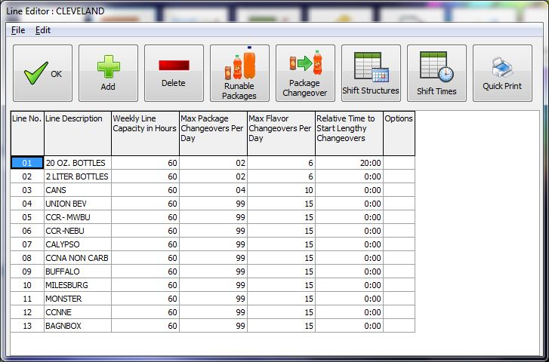
Edit Line Characteristics, Capacity, Change Over Limits

Slide 138
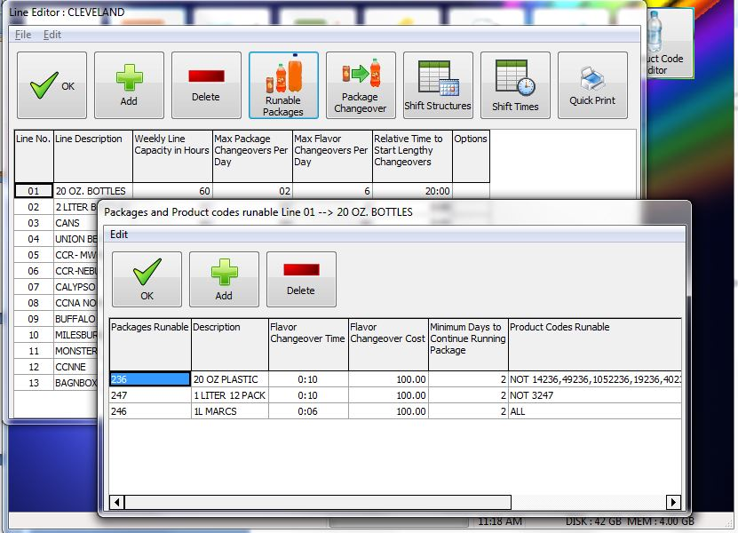
Define Which Package Sizes Can Be Run On Each Line

Slide 139
Define Specifically Which Product Codes Can Be Produced On Each Line

Slide 140
Edit Change Over Times and Costs From Package Size to Package Size

Slide 141
Edit SKU to SKU Change Over Times and Costs

Slide 142
Define Production Labor Shift Structure Preferences

Slide 143
Define Shift Start Times and Breaks In Relative or Absolute Time

Slide 144
Production Line Hours
Suggest / Schedule Production Line Hours
Set hours per line, day, & shift.
Computer suggestion using line priorities, forecasts, inventories.
Ability for user to manually override scheduled hours.

Slide 145
Schedule Line Hours

Slide 146
Suggested Production Line Hours Report

Slide 147
Generate Production Schedule
Production Schedule Generator
Can create Actual or Suggested schedule.
Can generate between any two dates.
Ability to generate for any plant & line.
User can manually schedule some lines and let the computer schedule the rest.
Very fast, can try “what if” scenarios quickly.
Flexible to regenerate any part of the schedule.

Slide 148
Production Schedule Generator

Slide 149
Production Schedule Generator

Slide 150
Production Schedule Generator

Slide 151
Production Schedule Generator

Slide 152
Production Schedule Generator

Slide 153
Production Schedule Editor
Editor
Lets the user see & modify the generated schedule.
Very detailed down to the minute, by line, by day.
Easy to rearrange runs with slide up/down.
Can "push forward" schedule if falling behind original schedule.
Comment capability.

Slide 154
Production Schedule Editor

Slide 155
Production Schedule Editor

Slide 156
Production Decision Support Tool Permits Semi Manual Assisted Scheduling

Slide 157
Production Decision Support Tool Permits Semi Manual Assisted Scheduling

Slide 158
Production Reports & Charts
Reports & Charts
Production Schedule suitable for posting and distribution to line workers.
Audit report provide complete trail of reasons why it suggested a certain schedule.
Estimated inventory and days supply on future day using schedule (verify correctness).
Charts and graphs to see production over time.

Slide 159
Chart Production By Line, Date, Package, and Product

Slide 160
Chart Production By Line, Date, Package, and Product

Slide 161
Production Flavor Analysis Charting

Slide 162
Production Package Analysis Charting

Slide 163
PRISM Computerized Inventory Management System
Raw Materials Scheduling & Ordering

Slide 164
Raw Materials Scheduling
Orders raw & packaging materials automatically by day, by line and by supplier.
Verifies correctness of orders, even after manual changes.
Supports JIT (Just in time) and Min/Max ordering.
Supports raw material substitutions.
Support multiple suppliers for each material.
Allows tracking of materials received, comparison to order.
Automatic estimates of inventory, if actual counts missing.
Comprehensive reporting. Supports fax modems & e-mail.
Adds consistency and standardization to the process.
Junior employee can order in absence of senior scheduler.
Saves management time, decision making & paperwork.
Easy to setup and use with minimal training.

Slide 165
Raw Materials Scheduling System Main Screen

Slide 166
PRISM screen shows raw materials generator preparing to create the orders.

Slide 167
PRISM screen shows raw materials editor for several truckloads

Slide 168
PRISM screen shows raw materials editor for several truckloads

Slide 169
PRISM screen shows raw materials calculator - a quick way to check and compute quantities from the B.O.M.

Slide 170
PRISM screen shows raw materials calculator - a quick way to check and compute quantities from the B.O.M.

Slide 171
Raw Materials Production Batch Tank Table Defines Minimum and Maximum Fill Requirements.

Slide 172
PRISM Computerized Inventory Management System
Driver Transport Scheduling

Slide 173
Driver Transport Scheduling
Schedules drivers, tractors and trailers from plant to warehouse.
Computes load requirements.
Supports cross-shipping and back hauls.
Works with warehouse delivery windows.
Reduce loading dock congestion and conflicting delivery times.
Provides advanced shipping notification for warehouse.
Can distribute workload evenly for drivers, warehouse personnel and production facility personnel.
Reduces the burden of fleet management decisions.
Improves management access to needed decision making data.
Improves efficiency of existing fleet equipment and manpower.
Adds consistency and standardization to transport.
Improves communication.

Slide 174
PRISM screen shows delivery windows
for a sales warehouse.

Slide 175
PRISM computes truck load requirements.

Slide 176
PRISM computes driver requirements.

Slide 177
PRISM suggests load combinations.

Slide 178
PRISM screen shows driver start time setup.

Slide 179
PRISM screen shows user preparing to generate
a suggested transport schedule.

Slide 180
PRISM Generating a suggested transport schedule
by testing permutations and combinations.

Slide 181
PRISM screen allows the user to create,
edit or view driver schedule details.

Slide 182
PRISM Computerized Inventory Management System
Distribution Scheduling System

Slide 183
Distribution Scheduling
Suggests transport trailer contents to maintain supply.
Helps remove human error from product distribution.
Helps reduce required inventory.
Increases customer satisfaction.
Helps reduce product double handling.
Frees personnel for other duties.
Prints load information on approved shipping documents.
Allows hand corrections in the event of unexpected problems.
Has the ability to reduce Department of Transportation (D.O.T.) violations.
Reduces misloads by replacing hard to read forms.
Is easy to setup and use with minimal training.

Slide 184
PRISM screen shows detail of a planned shipment.

Slide 185
PRISM allows the user to search
for a shipping record in many ways.

Slide 186
PRISM offers many shipping functions to make
loading and dispatching transports easier.

Slide 187
PRISM provides comprehensive shipping audit reports.

Slide 188
PRISM charting and analysis lets you
study shipping activity graphically.

Slide 189
PRISM charting and analysis lets you
study shipping activity graphically.

Slide 190
PRISM Computerized Inventory Management System
Integrated Reporting Charting & Analysis

